Slide 1
Energy Conservation
Notes:
Reduce unnecessary oxygen expenditure in the body. There are five major principles which can be
incorporated into daily activities. These principles are meant to be internalized
into daily habits.
1

Slide 2
Principles of Energy conservation
Prioritise
  Complete most important tasks first
  Delegate tasks
  Eliminate unnecessary tasks
Notes:
2

Slide 3
Principles cont.
Plan ahead
  When do I have most energy?
  Distribute jobs over the whole week.
  Alternate heavy and light tasks.
  Complete heavier tasks when feeling more energetic.
Notes:
Morning or afternoon
3

Slide 4
Principles cont.
Pace/Rest
  Regular rest breaks should be planned.
  Pace yourself – 30-40 minute tasks then rest.
  Avoid rushing.
  Listen to your body messages before you are exhausted.
Notes:
4

Slide 5
Work simplification
Exercise:
  Identify a common task you struggle with
  Discuss with your neighbour a way to complete the task with the energy conservation principles in mind.
Notes:
Posititoning
Give examples from home, set up kitchen (easy reach) etc.
<number>

Slide 6
Tips: Personal cares
Bathing | Complete when you have most energy Sit if able on chair or bath board
Grooming | Sit at hand basin Use electrical toothbrush
Dressing | Avoid tight clothing and shoes with laces Use a sock aid or an easy reacher
Toileting | Ensure there is proper ventilation. Consider a raised toilet seat or rails on the wall.
Notes:
Personal cares-
Sit to shower, dry and dress (where possible) – conserves
Use luke-warm water to reduce steam.
Make sure the bathroom is ventilated.
Use a towelling robe to assist with drying.
<number>

Slide 7
Tips: Preparing meals
Grocery shopping | Write a list prior to going. Order groceries online. Use wheeled trolley.
Meal preparation | Prepare meals in advance and consider freezing them. Cut food at a table rather than standing. Transport items with a kitchen trolley. Have items within easy reach.
Notes:
<number>

Slide 8
Tips: Household tasks
Laundry | Sit to sort, fold and iron laundry. Use a clothes rack rather than washing line.
Cleaning | Seek assistance. Stagger cleaning tasks throughout the week.
Gardening | Attempt to sit if able.
Notes:
<number>

Slide 9
Tips cont.
General
  Access a Mobility card via the GP to access disability carparks.
  Arrange everyday objects within easy reach.
  An OT referral can be accessed via your GP or other Health professional for a home based assessment.
Notes:
<number>

Slide 10
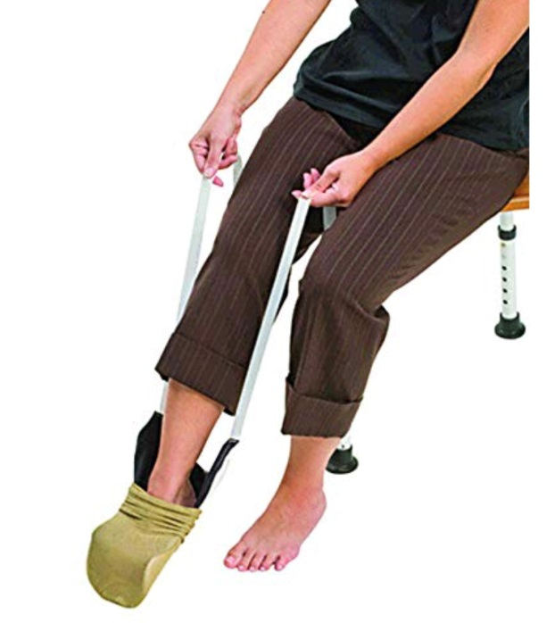
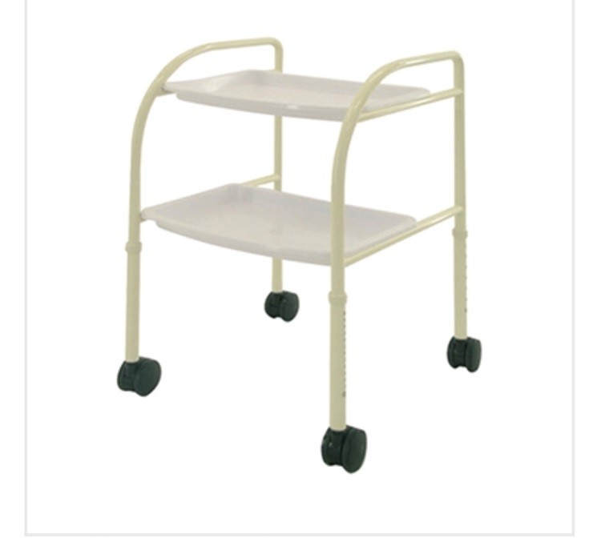
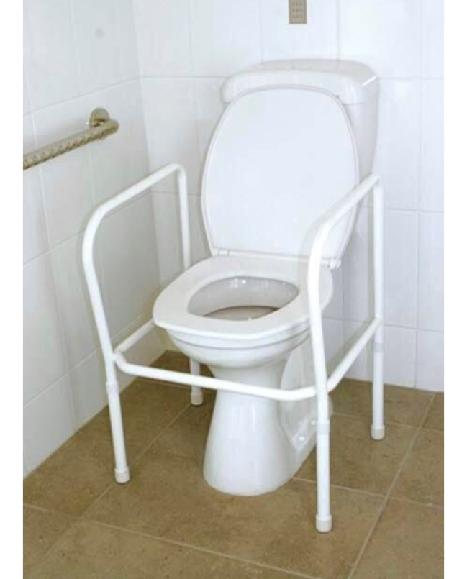
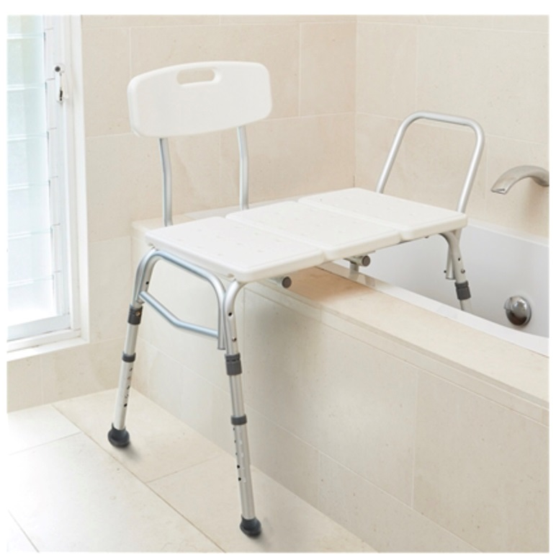
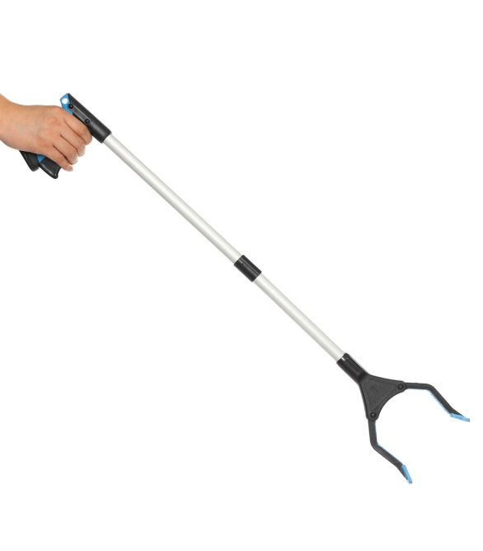
Assistive Equipment

